Slide 1
Cooking with AWS and Splunk
Module 6 : CloudFormation Templates
Kam Amir | Splunk Cloud Architect

Slide 2
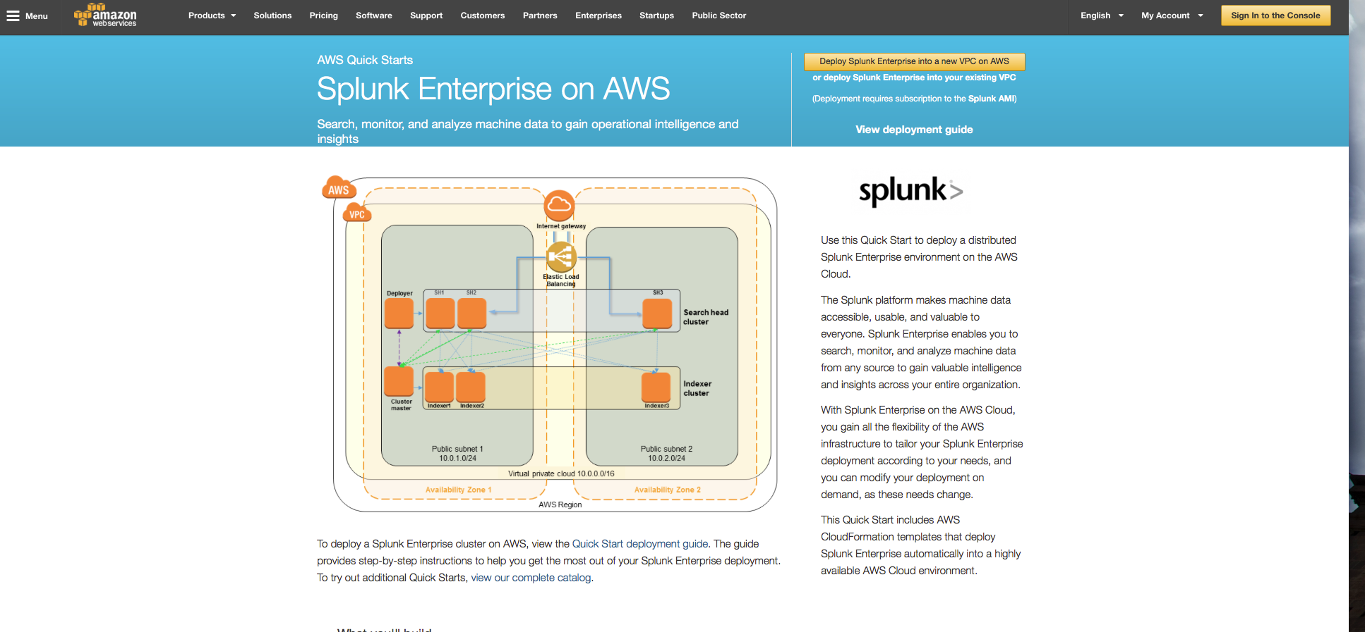
Splunk Quick Start on AWS
https://aws.amazon.com/quickstart/architecture/splunk-enterprise/

Slide 3
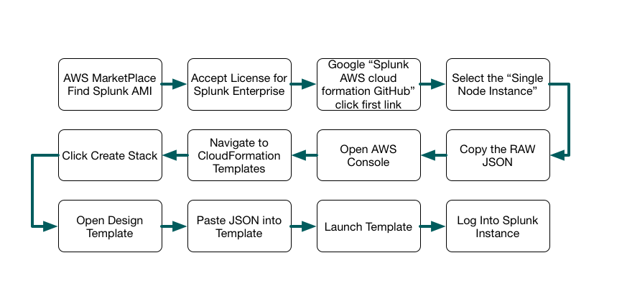
CloudFormation Workflow
Workflow for using CF Templates and Splunk

Slide 4
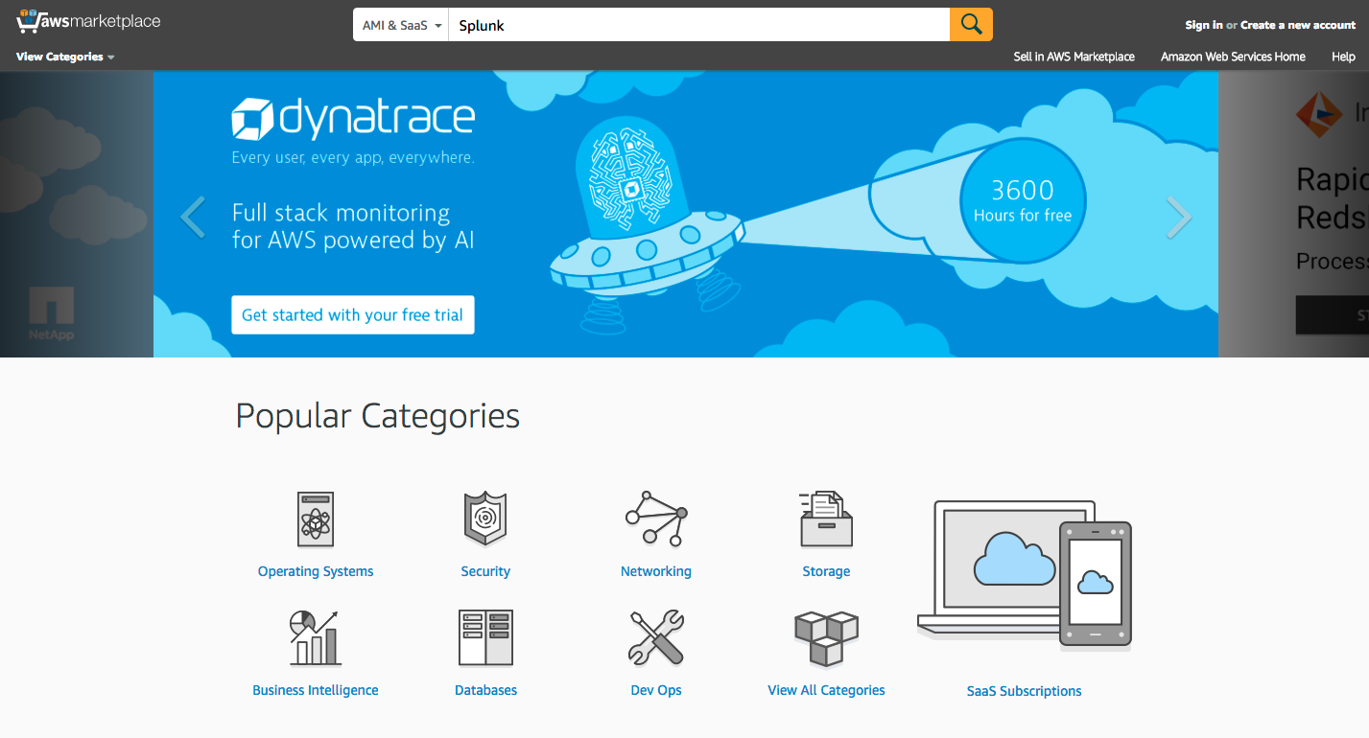
Go to AWS Market Place
Go to https://aws.amazon.com/marketplace, search for Splunk

Slide 5
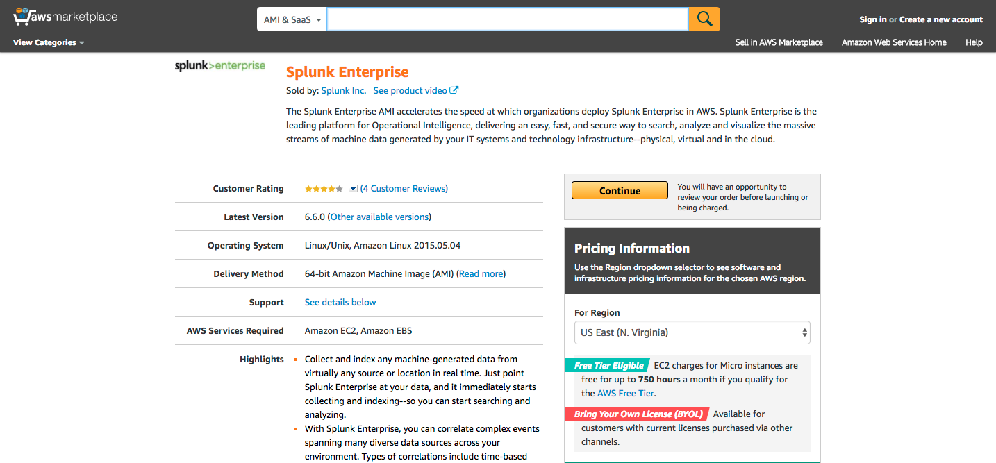
Find Splunk Enterprise
Click Continue (Sign Into AWS)
Click Here

Slide 6
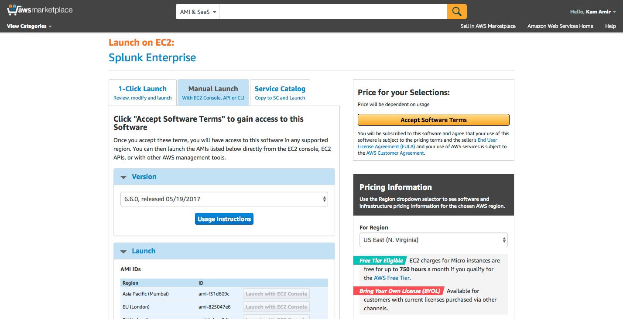
Accept Splunk License
Click on Manual Launch and Accept Software Terms
Click Here
Click Here First

Slide 7
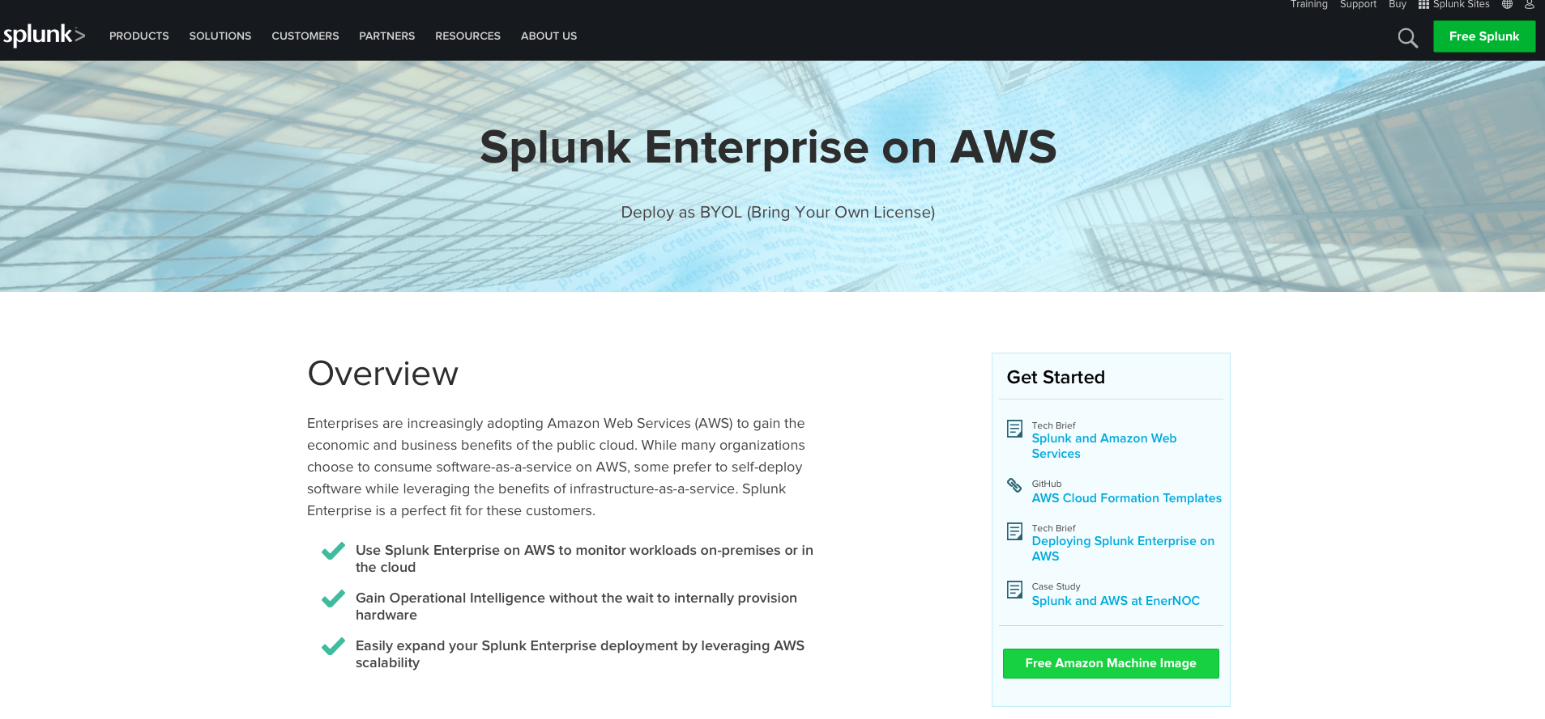
Where to Find Splunk on AWS
https://www.splunk.com/en_us/cloud/splunk-enterprise-on-aws.html
Click here for github link

Slide 8
CloudFormation Deploy
CloudFormation Build Process
Download Single-Node Instance Template - https://github.com/splunk/splunk-aws-cloudformation
Open CloudFormation Upload Template
Accept License for Splunk AMI via AWS Market Place
Install Dependency for AWS App:
Splunk ML Toolkit : https://splunkbase.splunk.com/app/2890/
Python for Scientific Computing (for Linux 64 bit) : https://splunkbase.splunk.com/app/2882/
Setup AWS Inputs

Slide 9
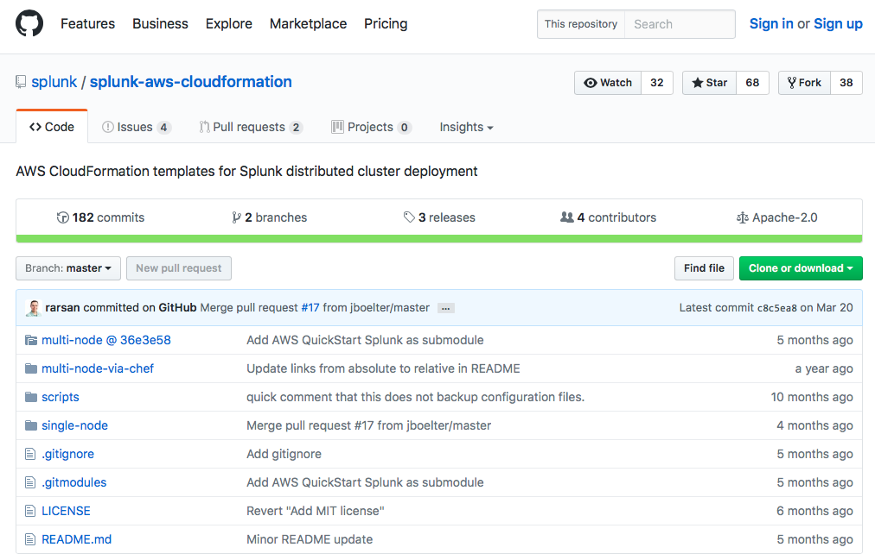
Enter GitHub to get templates
Select multi-node or single instance deployment
Multi-node
Multi-node
w/Chef
Single-Instance

Slide 10
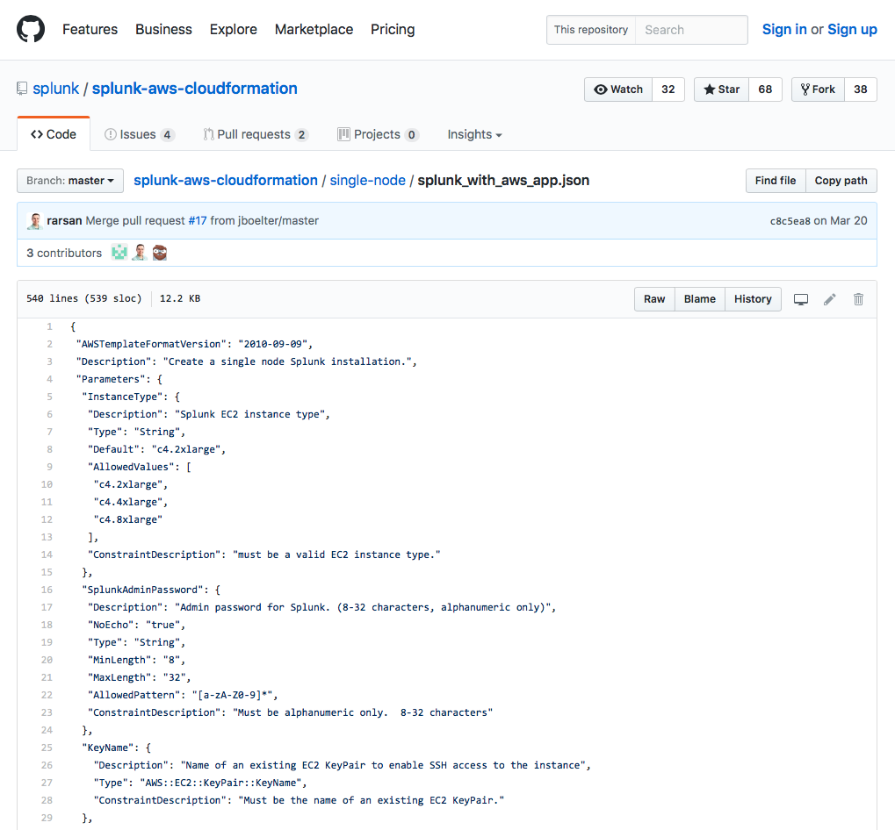
Select RAW JSON from GitHub
Click Here

Slide 11
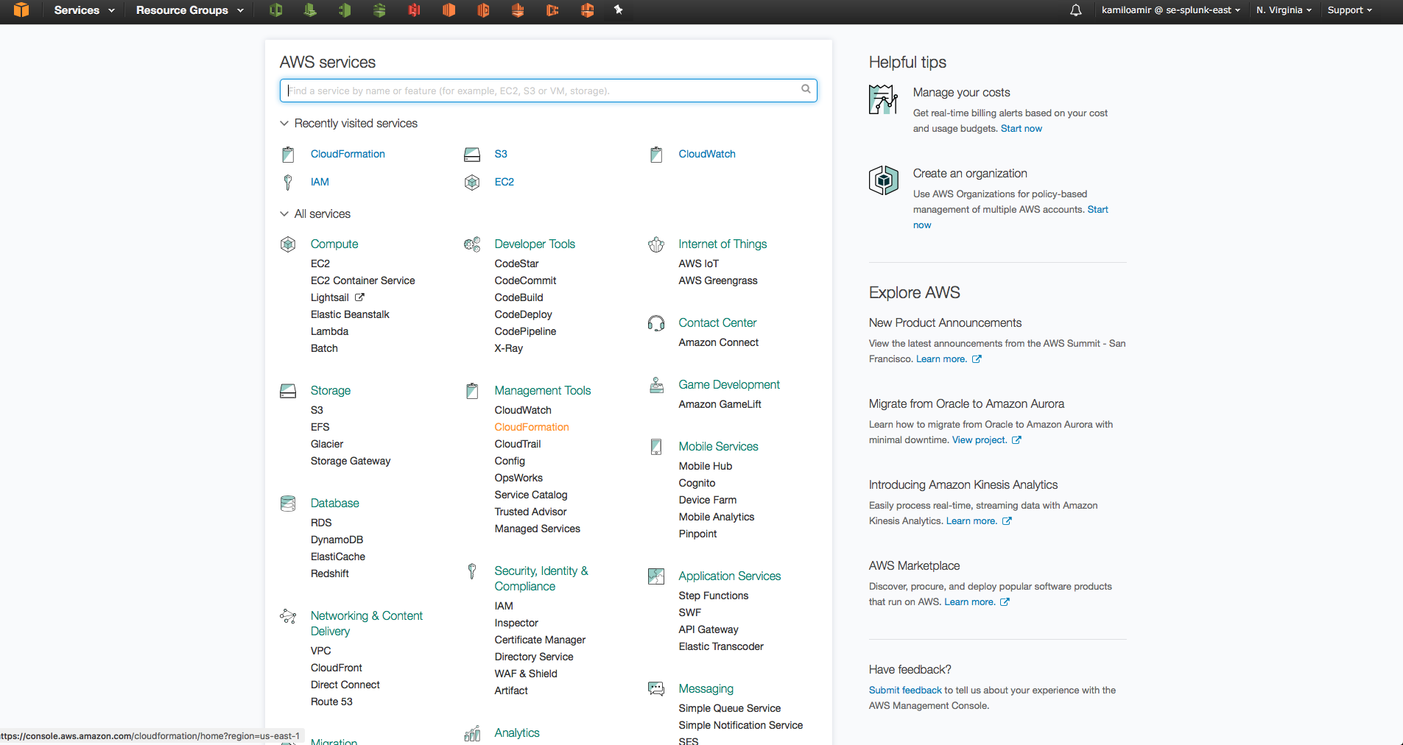
Open CloudFormation on AWS
Management Tools -> CloudFormation
Click Here

Slide 12
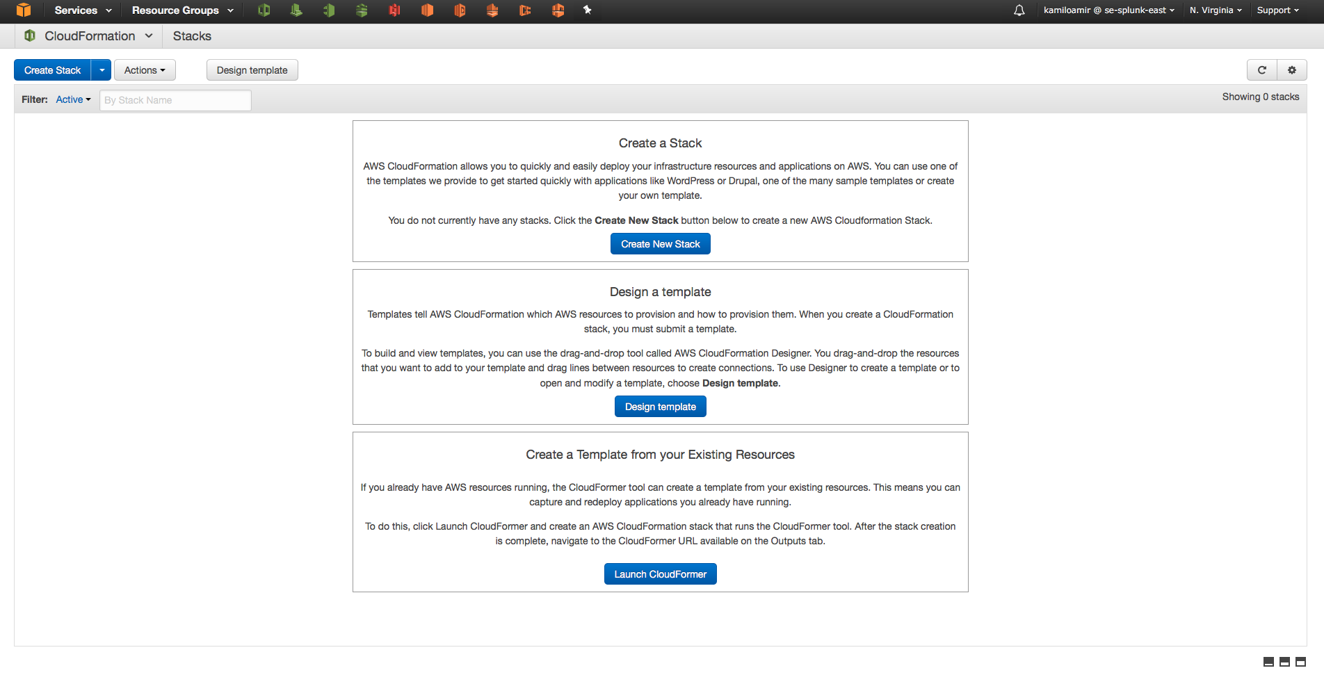
Create New Stack

Slide 13
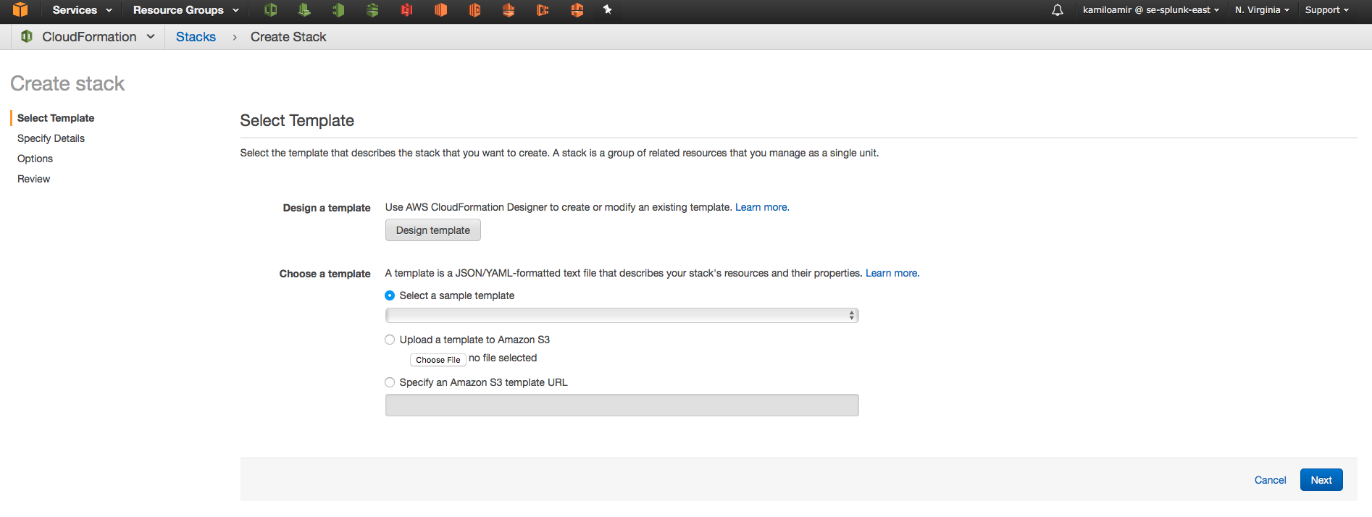
Click on Design template
Click Here

Slide 14
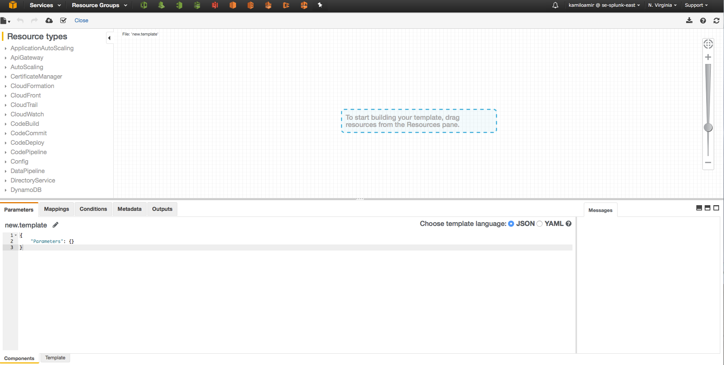
Locate the Template tab
Click Here

Slide 15
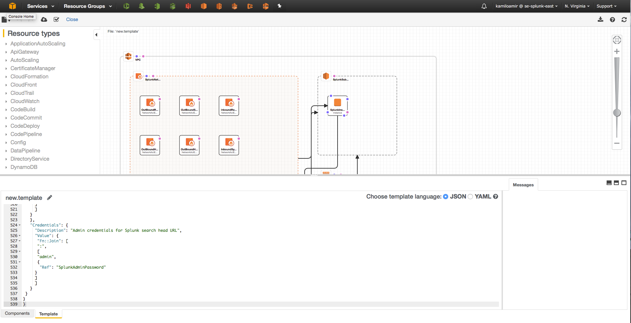
Paste JSON / Refresh
2) Click
Refresh
1) Paste JSON Here

Slide 16
Deploy CF Template
Click Here

Slide 17
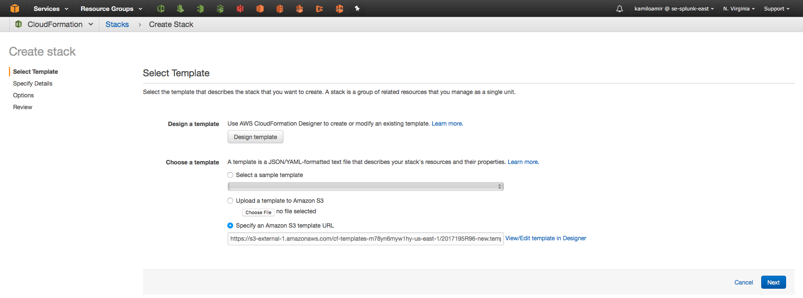
Select the template and click next

Slide 18
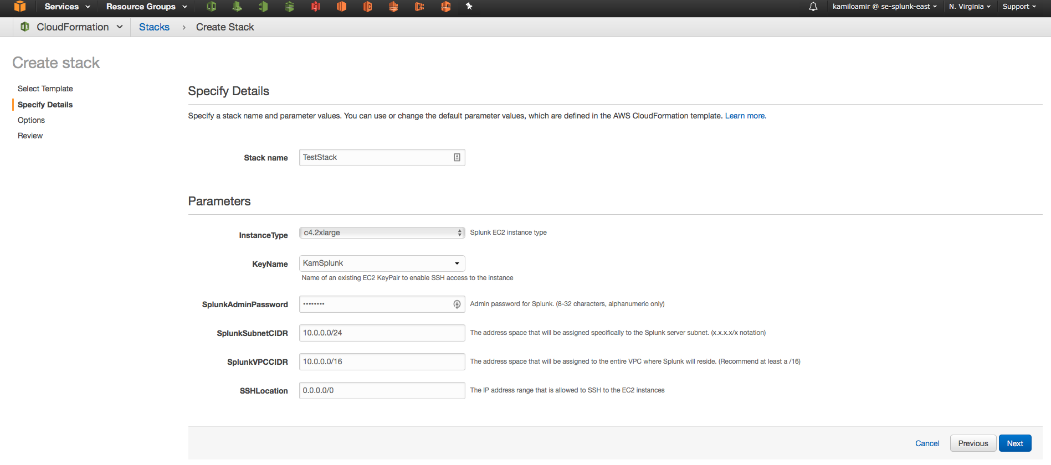
Fill out the form
Enter a “stack name”
Select a Key which you will use to SSH into the box
Change the password
Finally enter your IP or 0.0.0.0/0 to allow SSH from anywhere.

Slide 19
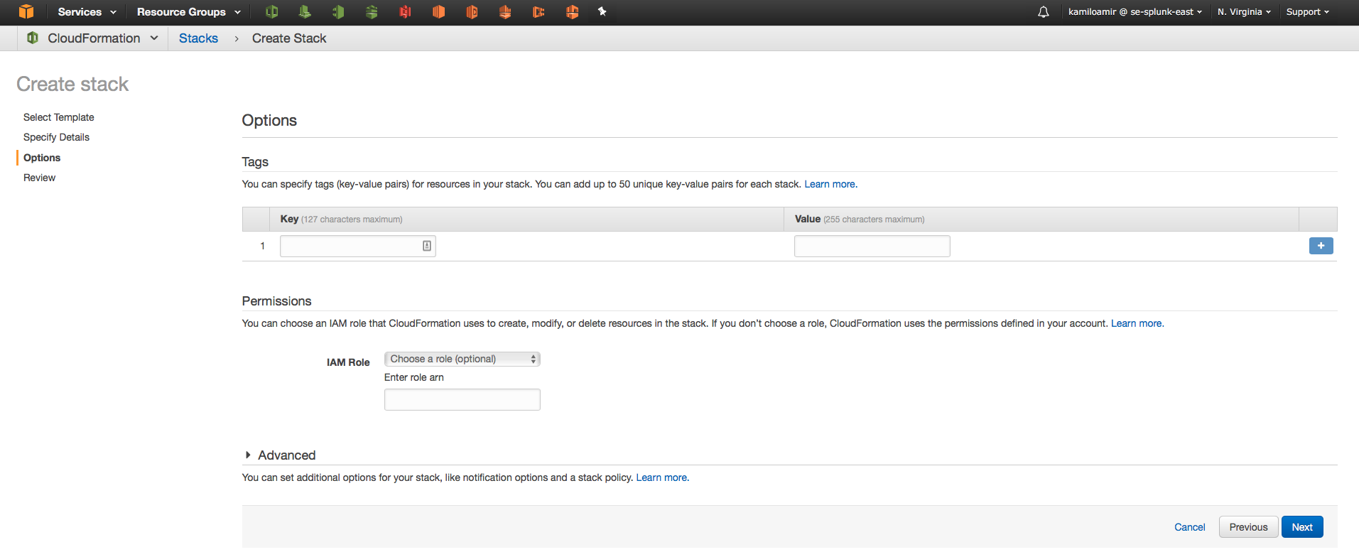
Fill out Tags / IAM Role
Add Tags or an IAM role for the EC2 instance(s).

Slide 20
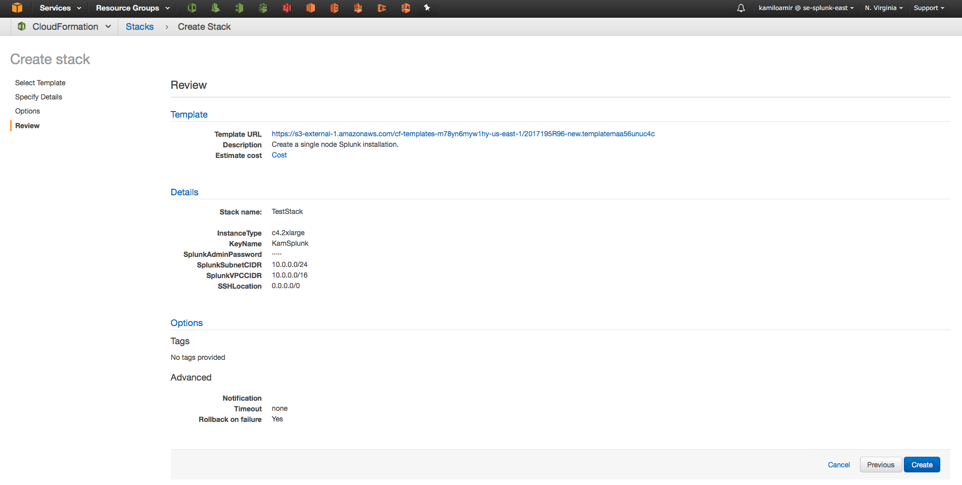
Review and Create Stack

Slide 21
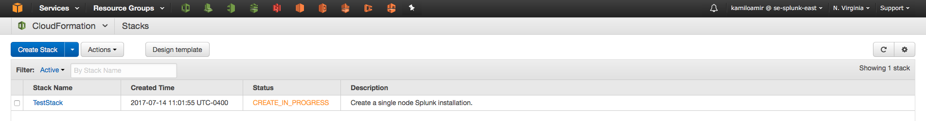
Watch Stack being provisioned
Click on the stack to get details

Slide 22
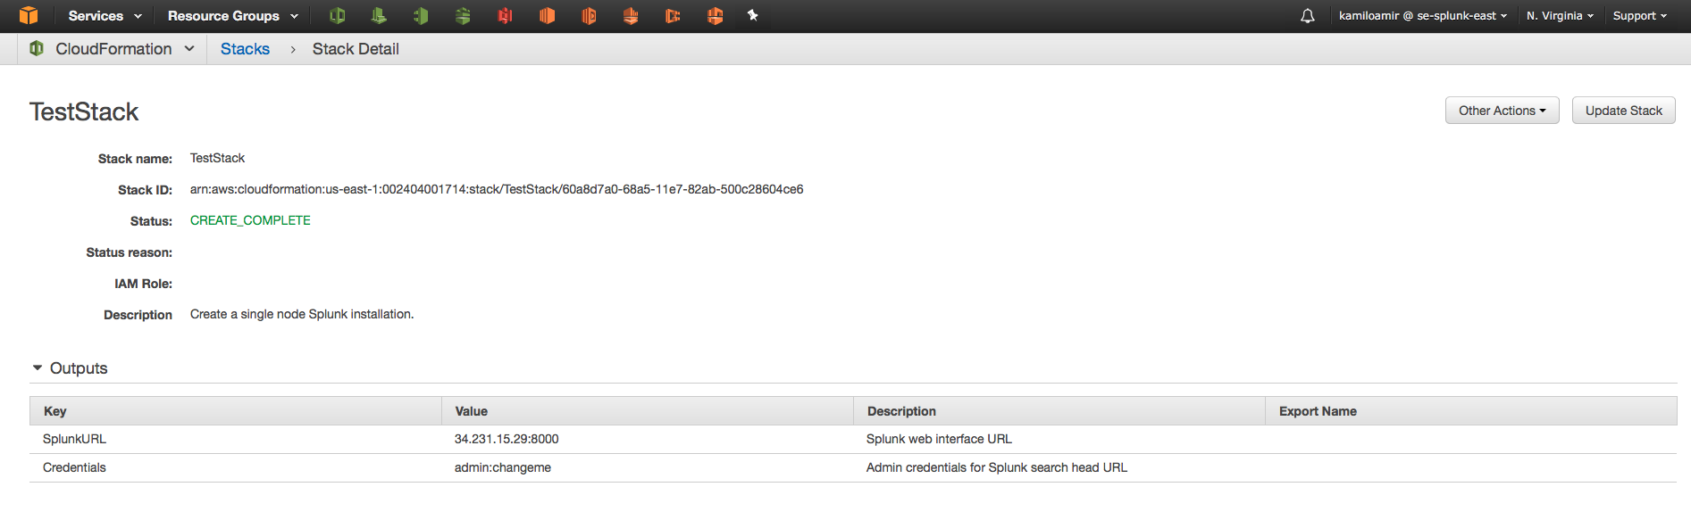
See Outputs once stack complete
Wait 10-15 minutes to make sure all post changes are made.

Slide 23
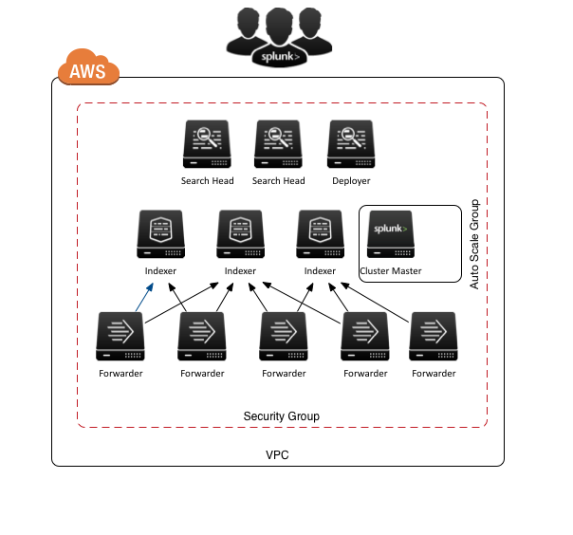
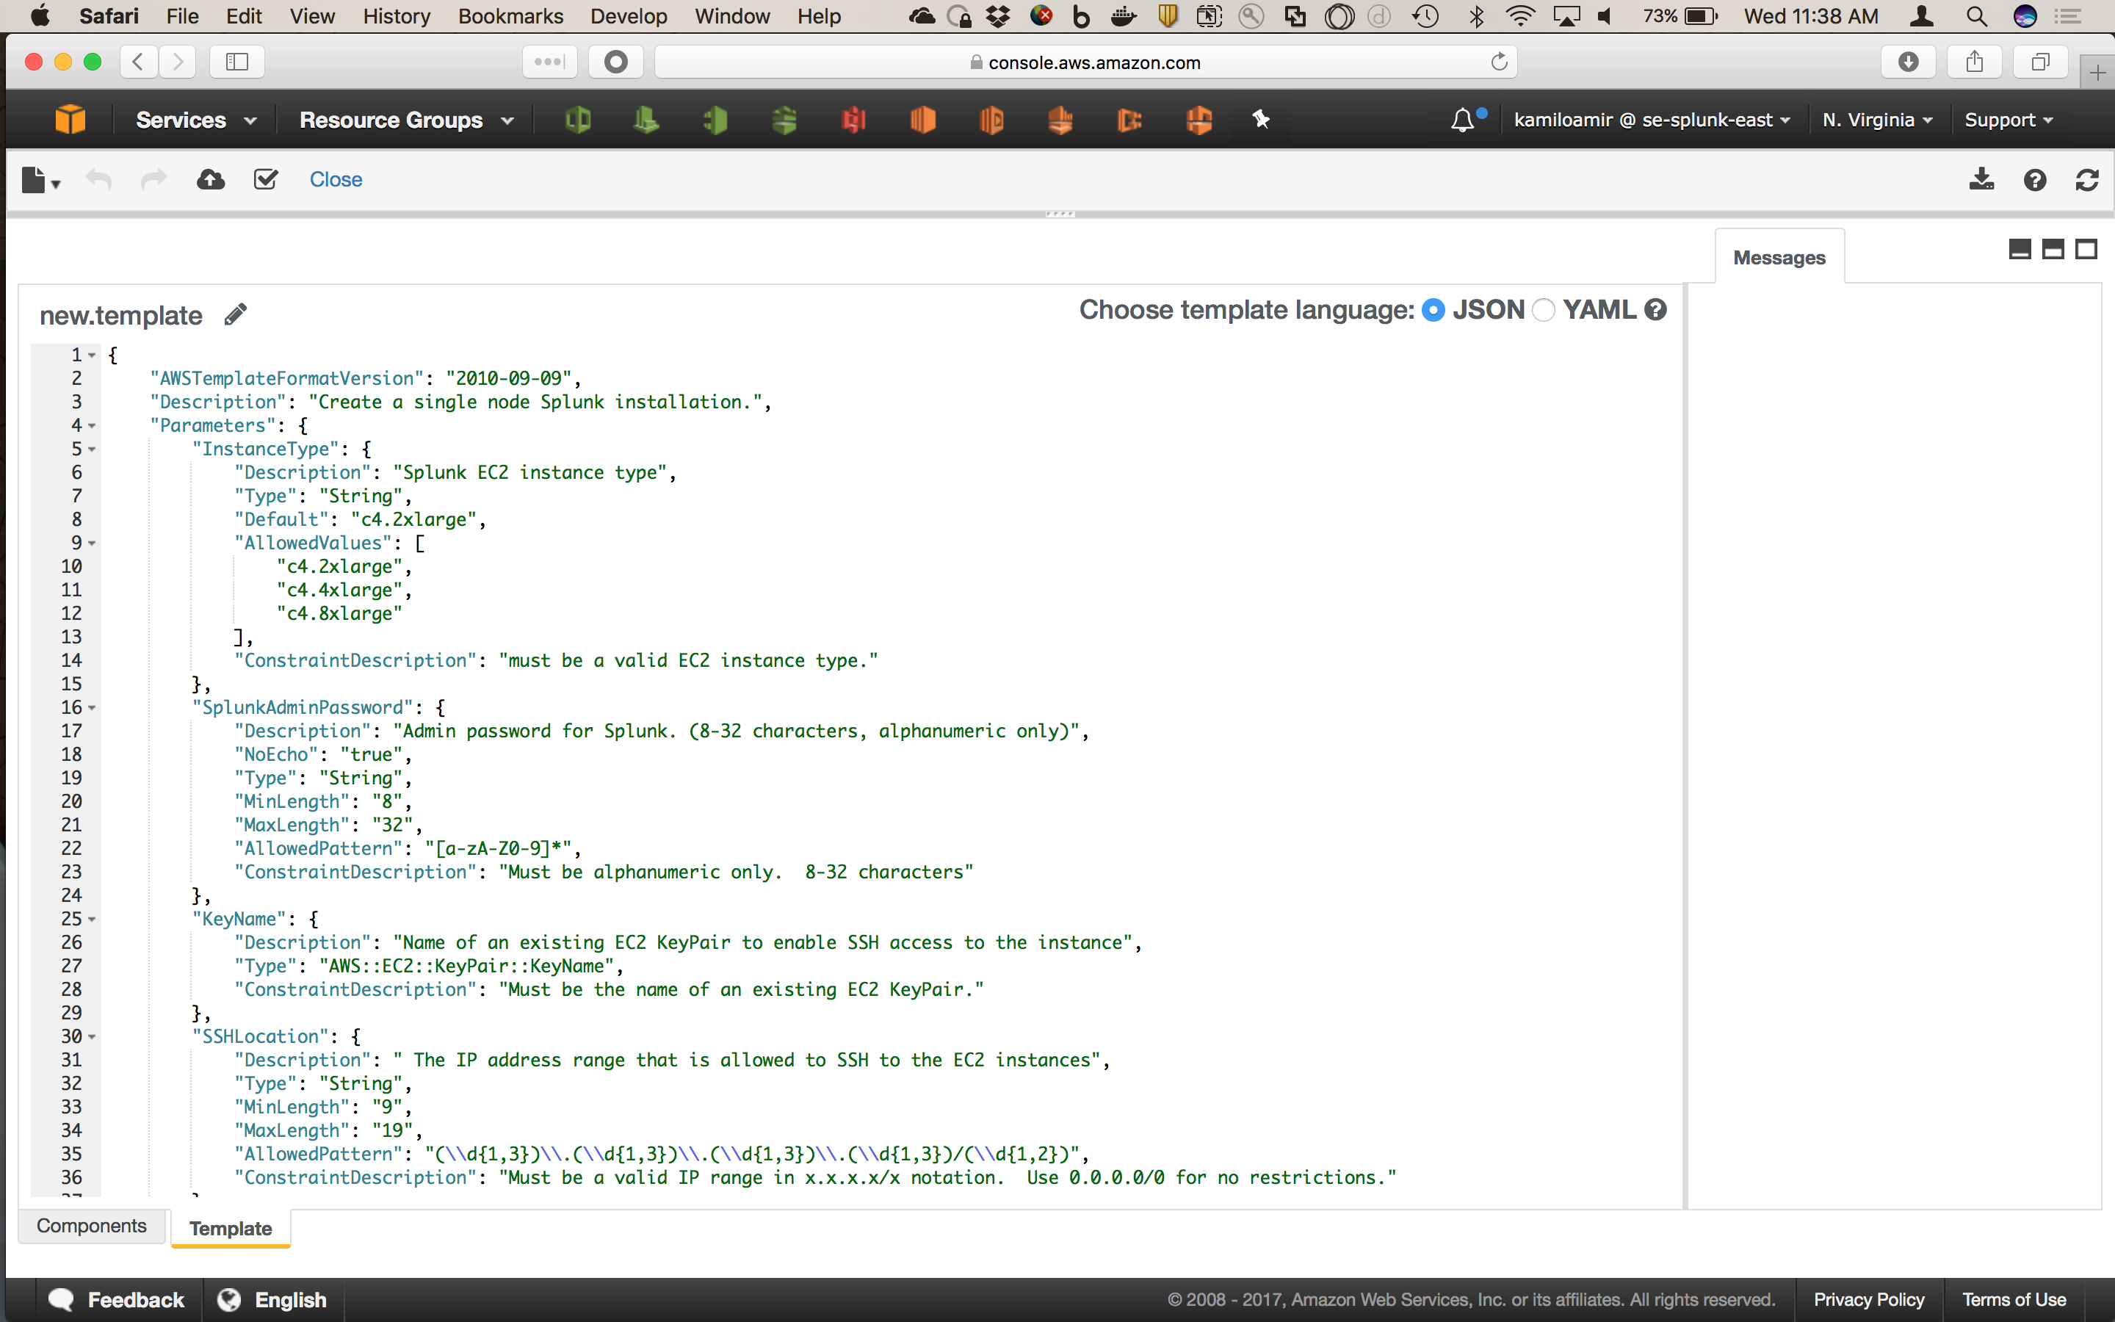
Splunk Quick Start
From code to deployment in 5 minutes
AWS CloudFormation Template
Fully Deployed Splunk Stack

Slide 24
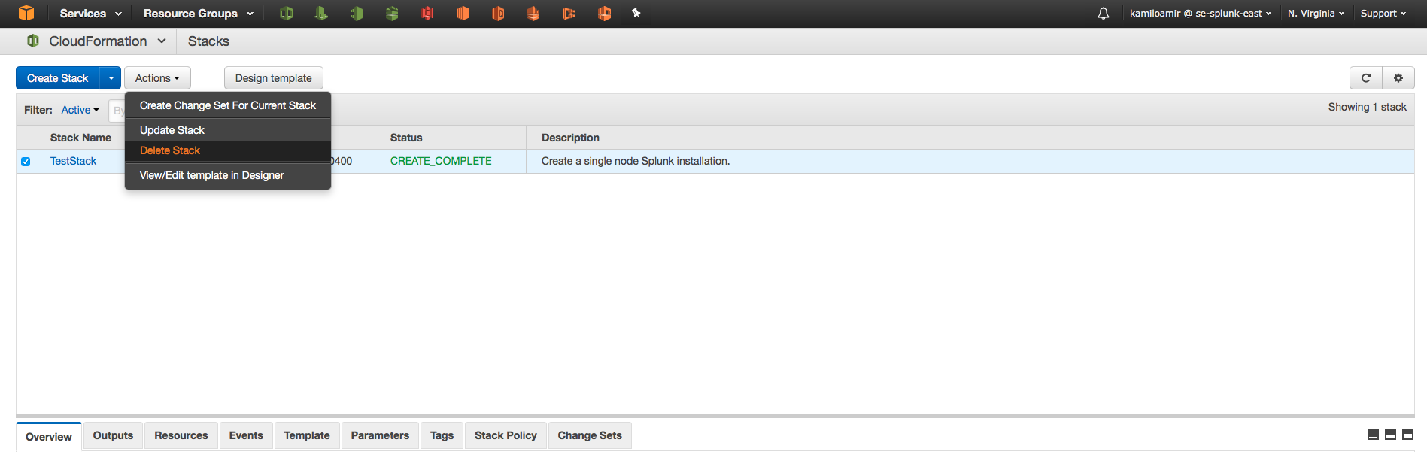
Delete Stack
Once you’re done, you can simply “Delete Stack” and it will remove all instances.

Slide 25
Continue to Module 7: Setup ELB HWF Tier

